Slide 1

Be Prepared ! Visitors are Coming ?
“ ’AirReg Website’ Restaurant Visitor Forecasting”

Slide 2


Data available through AIRRegi website
82 Restaurants across Japan
Time Period 1.5 years
Daily Visitors Records
Available Data:
air_store_id
visit_datetime
reserve_datetime
reserve_visitors
air_genre_name
air_area_name
latitude
longitude

Slide 3
Approach
Time Series (univariate)
Regression (multivariate)
Auto_arima(p,d,q)(P,D,Q,m)
p- autoregressive term
d- degree differencing
q- moving average order
P- seasonal autoregressive term
D- seasonal degree differencing
Q- seasonal moving average order
m- “mystery component”
Evaluation: AIC (Akaike Information Criterion) and BIC (Bayesian Information Criterion) values are estimators to compare models.
Engineer Features:
Deconstructed Date, Weekday,
Area, Geo Location, Food Genre,
Statistical Summaries
Fit, Transform, Evaluate:
Prophet (Facebook freeware)
Fully automated .
Built-in cross validation function.
Robust to outliers, missing data, sharp change.
Still has tunable parameters.

Slide 4
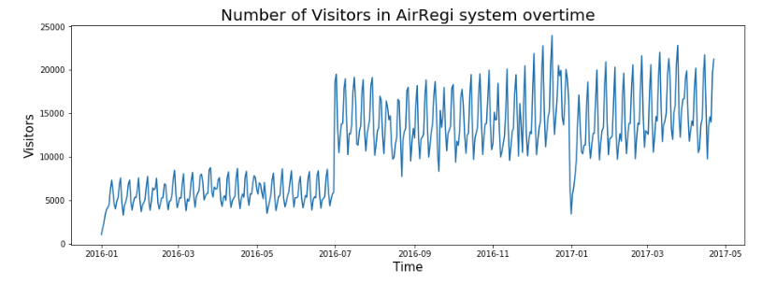
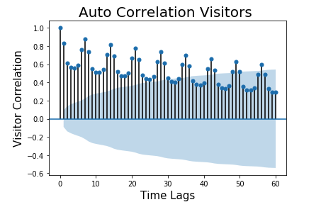
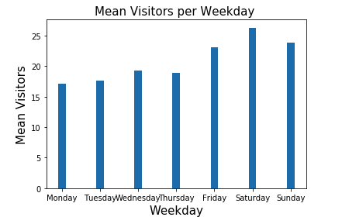
Exploring Data Time Correlation
Restaurants were added to the system June 2016
Strong weekly trends for all restaurants
Baseline prediction score was established
Baseline 1:
Mean visitors per weekday across for each restaurant
How about individual restaurant trends ?
 | RMSE | R^2
Baseline 1 | 16.43 | 0.04
Baseline 2 | 11.09 | 0.56

Slide 5
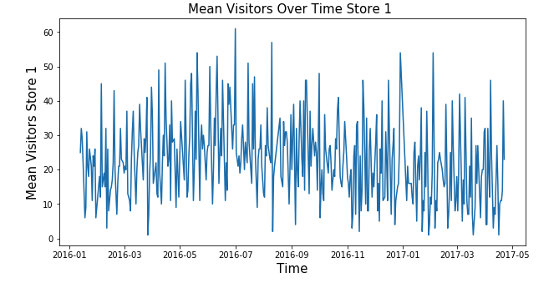
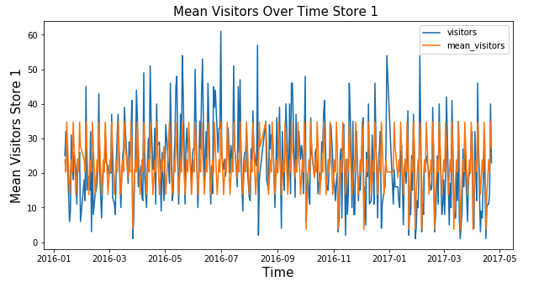
When Weekly Means are Not Enough
Mean number of visitors per weekday per each restaurant individually does not accurately predict future visitors
 | RMSE | R^2
Baseline 1 | 16.43 | 0.04
Baseline 2 | 11.09 | 0.56

Slide 6
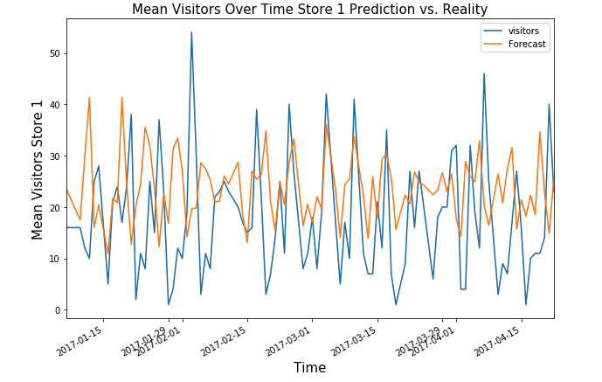
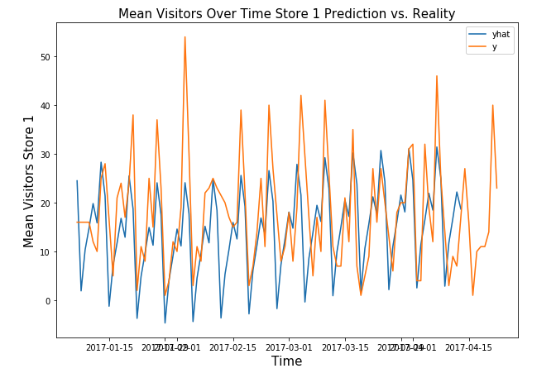
Does past visitors predict the future ?
Time series analysis with ARIMA and PROPHET
Does not accurately predict future visitors
PARTIALLY Yes/No
 | RMSE | R^2
Baseline 1 | 16.43 | 0.04
Baseline 2 | 11.09 | 0.56
autoARIMA | 14.14 | -0.59
Prophet | 14.97 | -0.79

Slide 7
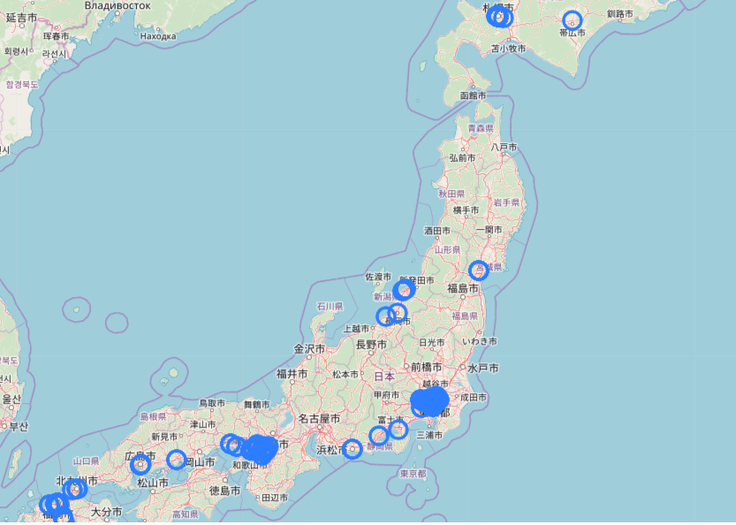
Exploring number of visitors in relation to restaurant specific factors.
Geo-Spatial location may predict future
visitors
Location relative to competition
Location relative to busy areas
Etc.

Slide 8
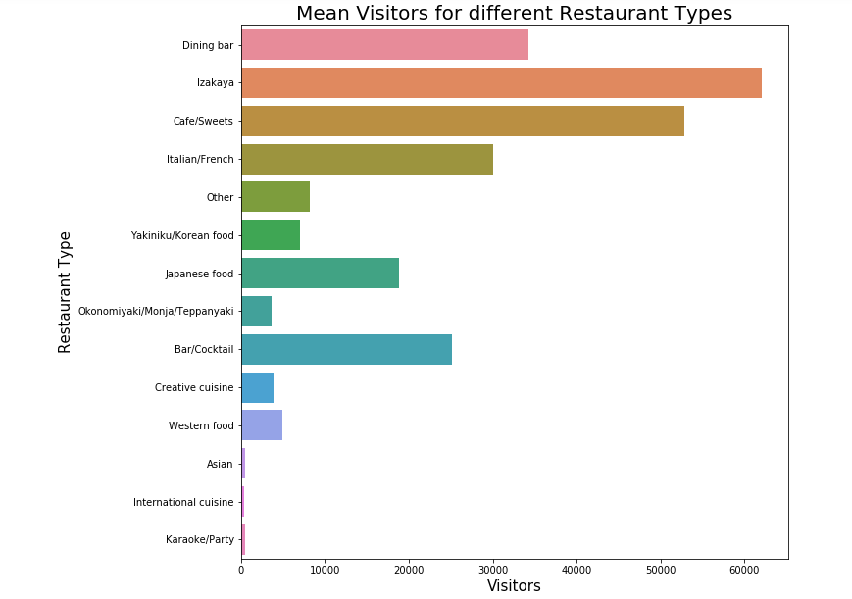
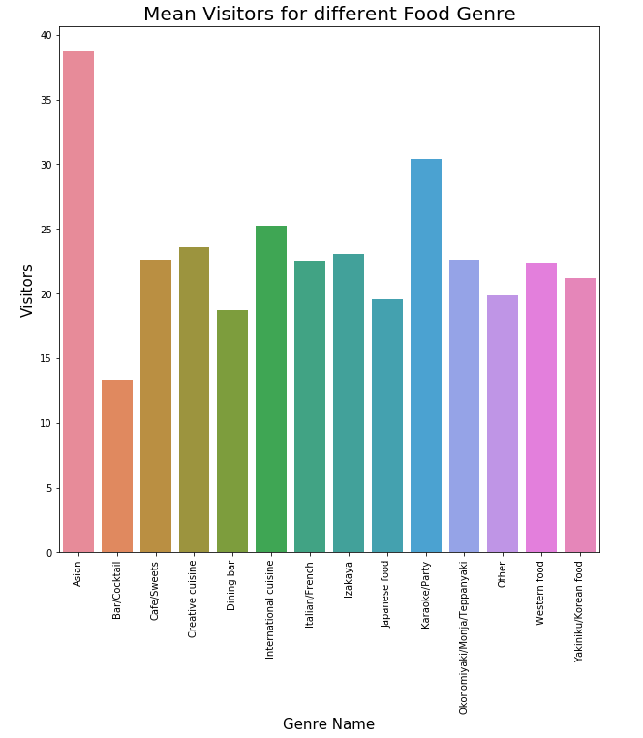
Visitor NUMBERS in relation to restaurant specific factors.

Slide 9
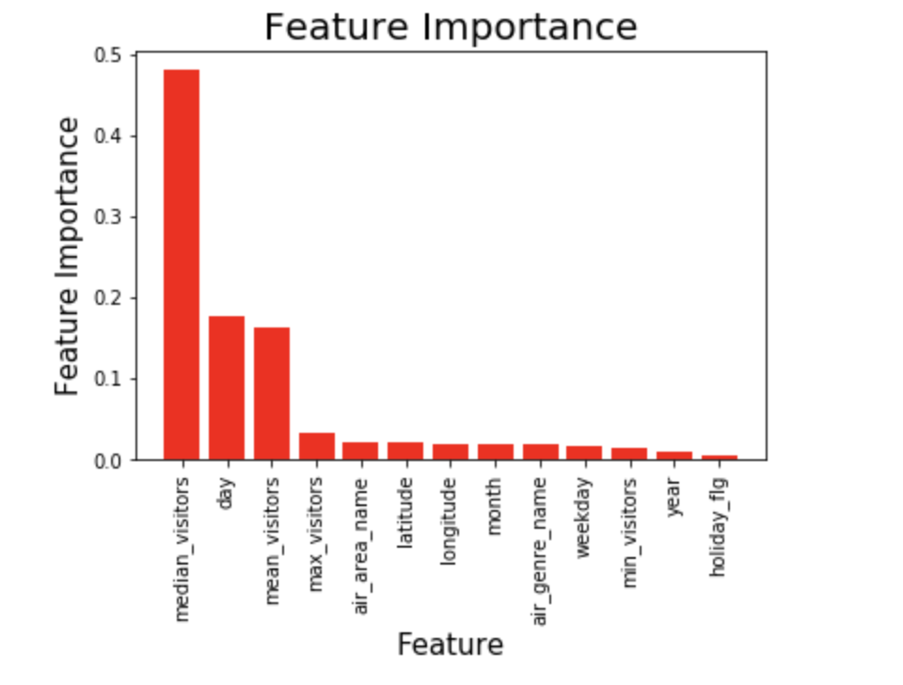
Feature Engineering for Regression Analysis
How to turn our limited data into additional fieatures:
Date: 05-17-2019 --> 5, 136, 2019, Friday
Latitude, Longitude: 35.65, 139.75
Visitors: 25. → min: 7 , mean: 23.8, median: 25, max: 57
Genre_name: Dinig bar
Area_name: Tokyo-to-Minato-ku-Shibakoen
Holiday: Yes

Slide 10
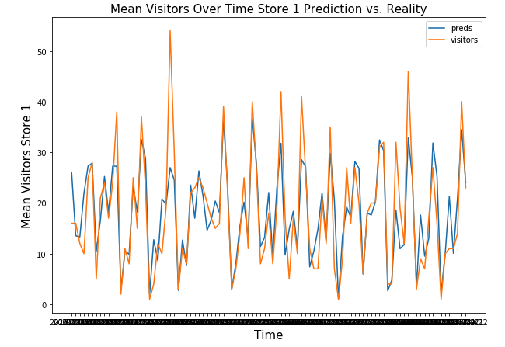
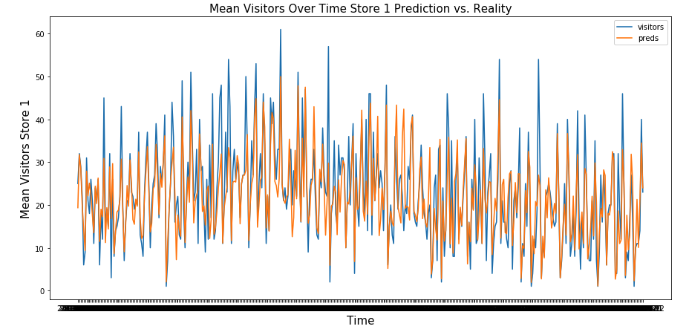
Do circumstances and the past visitors predict the future ?
Regression analysis with multiple engineered features
More accurately predict future visitors
Features added:
geo-spatial latitude and longitude,
cuisine genre, type of restaurant,
week-day specific visitors minimum, maximum, mean, median for each specific restaurant ,
year, month and date
YES !
 | RMSE | R^2
Baseline 1 | 16.43 | 0.04
Baseline 2 | 11.09 | 0.56
autoARIMA | 14.14 | -0.59
Prophet | 14.97 | -0.79
MultiRegression | 0.356 | 0.8

Slide 11
Conclusions
Prediction of daily visitors at different restaurants in Japan depends on many different parameters, including date, location, cuisine genre, restaurant type.
This type of data is easily accessible through combination of data mining and datasets collected through AirRegi/Restaurant board website.
Accurate forecasting of future restaurant visitors was achieved via data science modeling process and may be used to significantly relieve the pressure of planning daily operations in tough restaurant business.

Slide 12
Future Directions
Future Vistitor Forecasting was successful with engineered features and a regression model.
More features could be explored:
Example1: Geo-spatial data to determine spatial proximity of each restaurant from busiest areas.
Example 2: Weather in different areas of the country.

